Slide 1
Ch. 2 vocab (7-15)

Slide 2
7. dragon boat

Slide 3
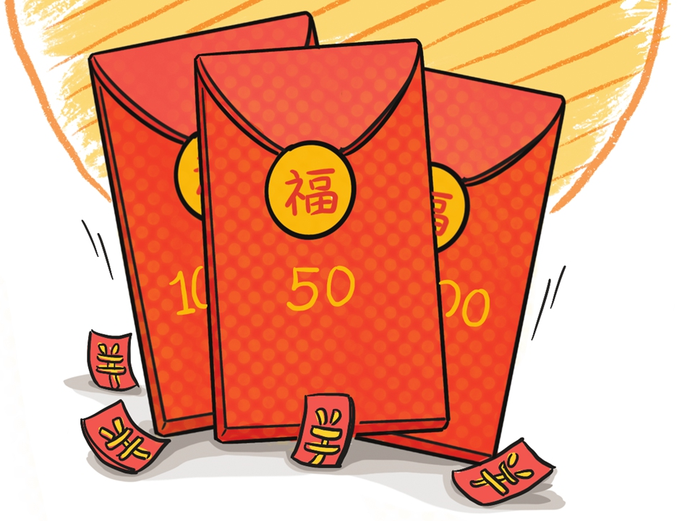
8. lucky money

Slide 4
9. moon cake

Slide 5
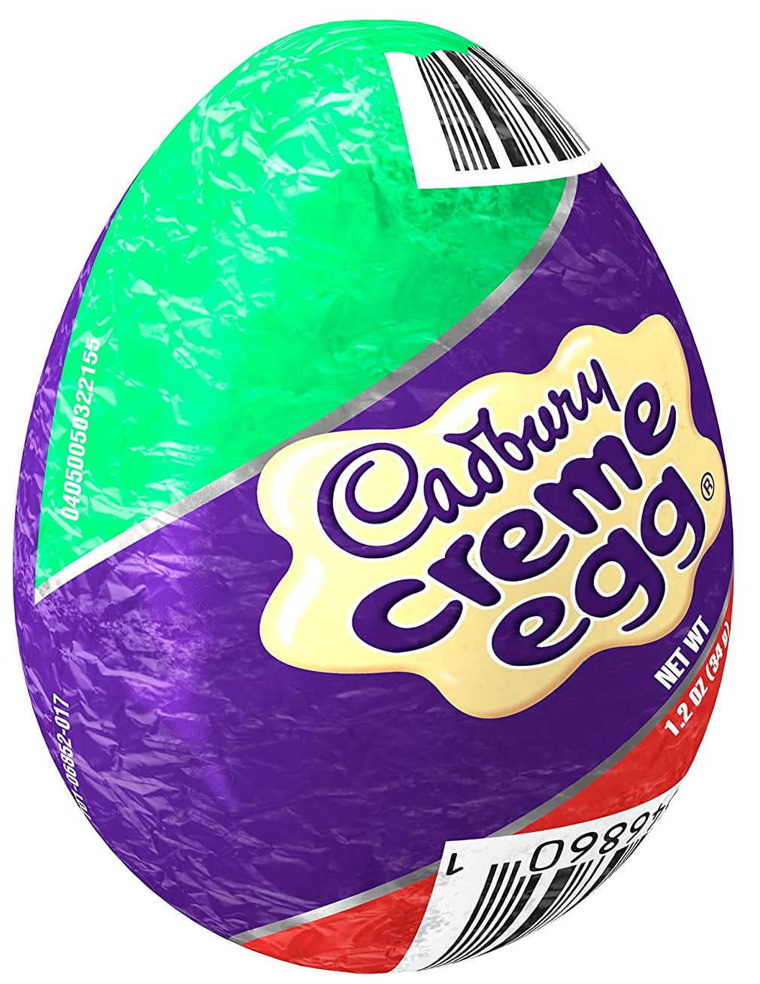
10. chocolate egg

Slide 6
11. fireworks

Slide 7
12. present

Slide 8
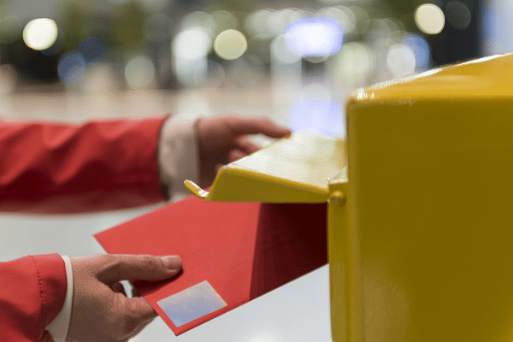
13. send

Slide 9
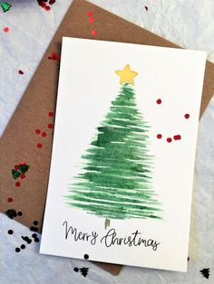
14. card

Slide 10
15. which

